Slide 1

TUNED MASS DAMPER ANALYSIS
VIBRATION AND NOISE CONTROL

Slide 2
OBJECTIVE
TO ANALYSE AND COMPARE THE VIBRATIONS
OF A SYSTEM IN DIFFERENT CASES :
Static & Dynamic motion of Pendulum

Slide 3

basic idea for solution

Slide 4
Analysis: EXPERIMENTAL
Graphs of Displacement, Acceleration of the top frame
are obtained through the accelerometer attached
to the frame which is connected to an arduino.

Slide 5
Analysis: Matlab (Theoretical)
Analysis of vibrations when pendulum is
static and dynamic
Comparison of vibrations with different lengths of the pendulum

Slide 6

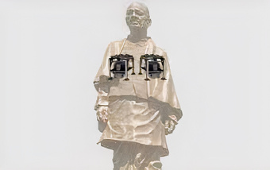
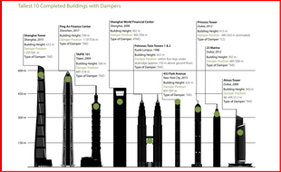

Slide 7
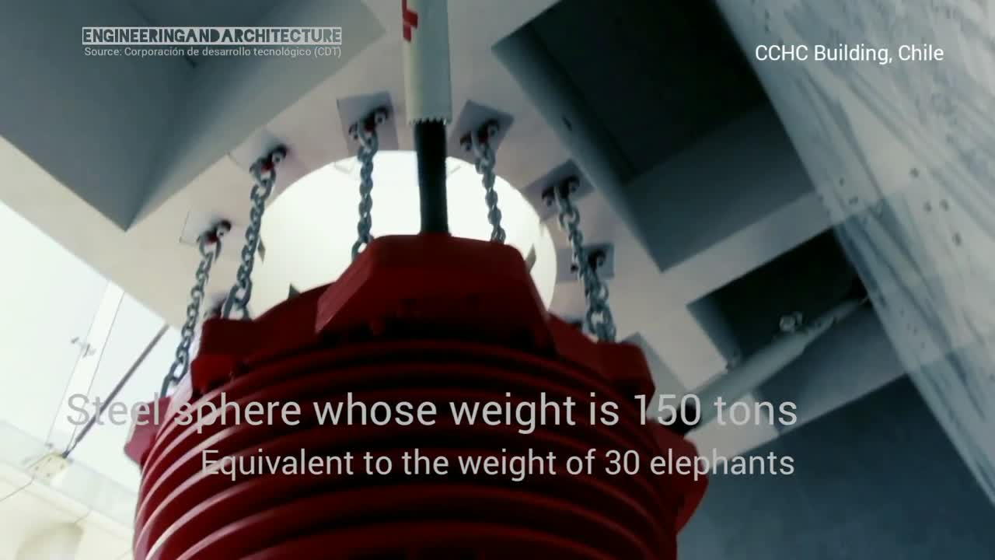
Seismic Event : Taipei(China) Skyscraper

Slide 8
REFERENCES
https://www.sciencedirect.com/science/article/pii/S1877705817335166
http://jase.tku.edu.tw/articles/jase-201406-17-2-05
https://pdfs.semanticscholar.org/b329/d5a12649ab75345344f21c2deb4a6714cd84.pdf

Slide 9
THANK YOU
Satya Srikanth 22117075
Jayendra 22117001
Pooja 22117094
Jawahar 22117084

